Slide 1
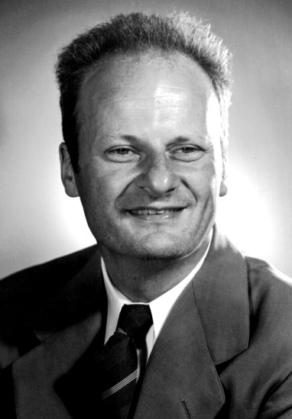
Famous
Astronomers
Hans Bethe
Contrast Optical Binary

Slide 2
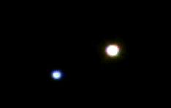
Beta Cygni Through the Telescope

Slide 3
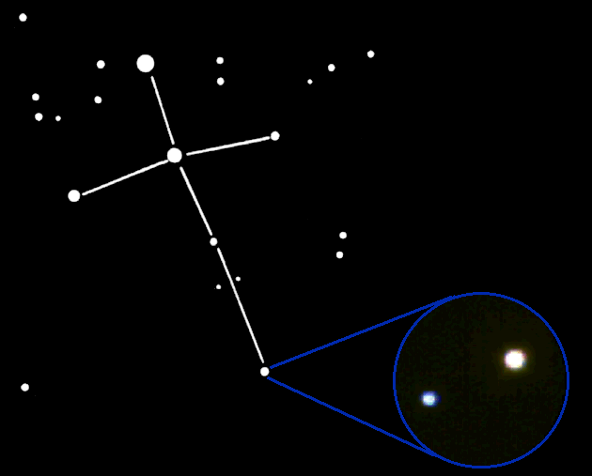
Finding Beta Cygni in the Night Sky
Beta Cygni is in the constellation Cygnus, the Swan.

Slide 4
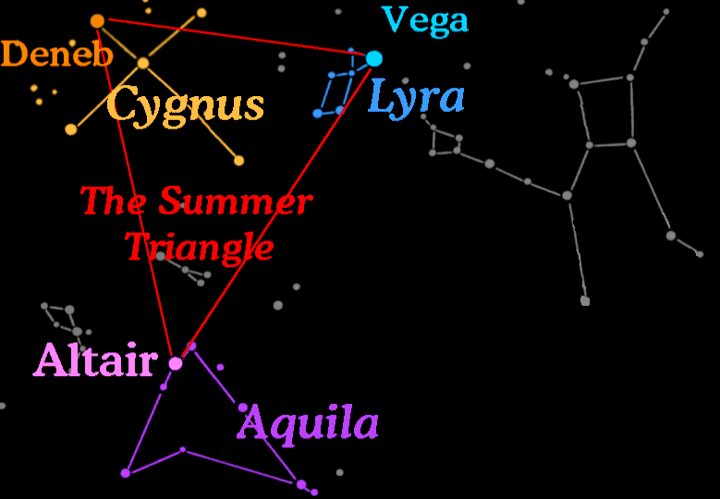
Three bright stars called the "Summer Triangle" can be used to find the constellations Cygnus the Swan, Lyra the Harp, and Aquilla the Eagle.

Slide 5

Star Pairs
Pairs of stars come in two forms:
Optical Double Stars
Binary Stars

Slide 6


Binary Stars
In a Binary (or Multiple) star system the stars are together in space and in orbit around each other.

Slide 7
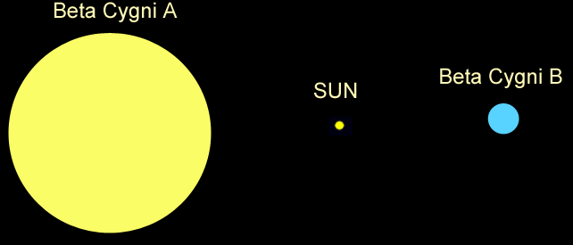
Size Comparison
The yellow star, Beta Cygni A, is 4 times the mass of our Sun, and 20 times larger!
The blue star, Beta Cygni B, is 6 times the mass of our Sun and 3 times the size.

Slide 8
Contrast Double Stars
Beta Cygni is called a 'Contrast Optical Double' because the stars have different colors.

Slide 9
Why Are Stars Different Colors?
Stars form with different amounts of hydrogen. High-mass stars have lots of hydrogen so they burn hotter and faster than stars with less fuel.
So, high-mass stars have different colors, temperatures, and life-spans than low-mass stars.

Slide 10
Contrast Double Stars
Blue stars are more massive and hotter than yellow or red stars. Stars of different masses evolve differently.

Slide 11
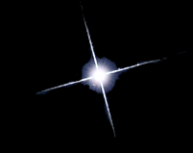

Types of Middle-Aged Stars
Blue stars are
high-mass hot stars.
Yellow stars are similar to our Sun. They are average in mass and temperature.
Red stars are
low mass and cool.

Slide 12
Beta Cygni
The blue star is the hotter of the two, yet the yellow star is the brightest.

Slide 13
How Can a Star be Brighter if it is Cooler?

Slide 14
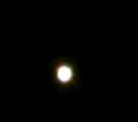

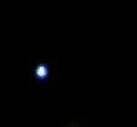
How Can a Star be Brighter if it is Cooler?
Two possibilities:
If it is an Optical Double, the cooler star may be nearer to Earth.
If it is a Multiple star, the cooler star may be larger.

Slide 15
Contrast Optical Double Stars
In this case, the yellow (cooler) star is actually further away than the blue (hotter) star.
So, if the yellow star is brighter, it must be larger.
The yellow star is running out of fuel and beginning to die, so it is turning into a giant.

Slide 16
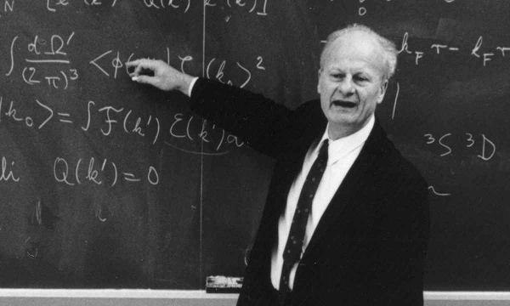
How do Stars Produce Energy?
In 1938, Hans Bethe explained the mechanism by which stars produce energy while converting hydrogen into helium through nuclear fusion reactions in their cores.

Slide 17
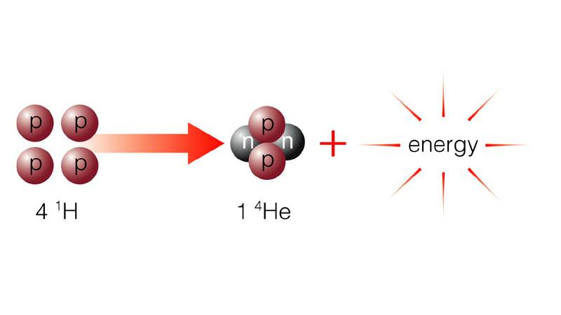
How do Stars Produce Energy?
4 Hydrogen 1 Helium
The proton–proton chain reaction is the dominant process by which stars the size of our Sun convert hydrogen to helium and produce energy.

Slide 18
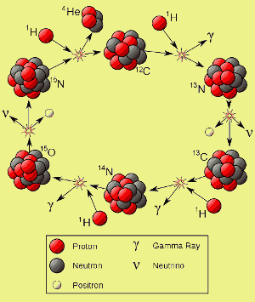
How do Stars Produce Energy?
The CNO cycle is another fusion reaction by which stars more than 1.3 times the mass of our Sun convert hydrogen to helium and produce energy.

Slide 19
How do Stars Produce Energy?
When stars run out of hydrogen in their cores, they expand and eventually begin to fuse helium into carbon in their core.
Red Giant Star
Main Sequence Star
H HE
HE C
H HE
Hydrogen core fusion
Core Helium fusion dominates

Slide 20
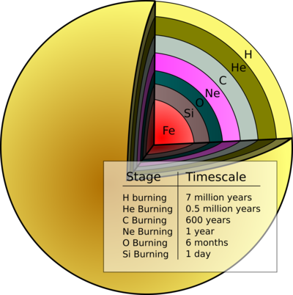
How do Stars Produce Energy?
In the most massive stars, when the helium in the core is gone, carbon then fuses into oxygen, oxygen fuses into neon, and so on When the end-product of the fusion reactions is iron, the process stops and the star explodes.

